Slide 1



Operating System
Prof. Ruchika Chouhan Assistant Professor
Computer & Science Engineering

Slide 2


CHAPTER-5.1
Memory Management

Slide 3
Topics
Memory Management: Basic Concept.
Logical and Physical address map.
3. Memory Allocation: Contiguous Memory Allocation.
4. Fixed and Variable Partition.
5. Internal and External Fragmentation and Compaction.
6. Paging: Principle of Operation.
Page Allocation.
Hardware support for paging

Slide 4
What is Memory Management?
Memory Management is an important characteristic of the Operating System. This comes beneath one of the two main capabilities of an Operating System, useful resource management. Main memory (RAM) is where maximum of the programs run. It is one of the most important matters people search for whilst buying a new cellphone or a new laptop.

Slide 5
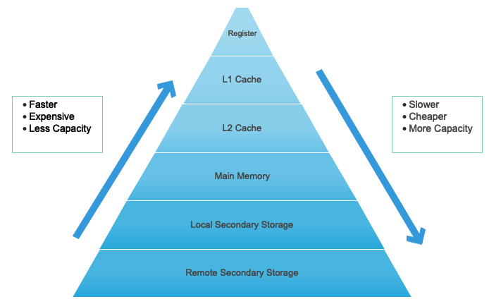
What is Memory hierarchy ?
In computer system architecture memory Hierarchy is part to arrange the memory in a such a way it can minimize access time.
Figure - 1 Memory Hierarchy [1]

Slide 6
Logical and physical address
Logical address is CPU generated address and it generate while program is running.
It considers as a virtual address and it not exist physically.
It use as a reference for access Physical memory point by CPU.
In a memory physical location identifies by Physical address.

Slide 7
Logical and physical address
Physical address not directly access by the user but it can be accessible by its corresponding logical address.
The term Physical Address Space is utilized for every physical location relating to the logical addresses in a Logical location space.
MMU computes Physical address.

Slide 8
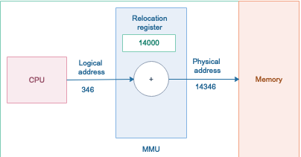
What is Memory hierarchy ?
It is a hardware device which uses to map virtual address to physical address.
Figure - 2 MMU [2]

Slide 9
Binding of Instructions and Data to Memory
Compile time: Helps to convert symbolic addresses to absolute addresses. If you know at compile time where the process will reside in memory, then absolute code can be generated (Static).
Load time: The compiler translates symbolic addresses to relative addresses. The loader translates these to absolute addresses. If it is not known at compile time where the process will reside in memory, then the compiler must generate relocatable code (Static).

Slide 10
Binding of Instructions and Data to Memory
Execution time: If the process can be moved during its execution from one memory segment to another, then binding must be delayed until run time. The absolute addresses are generated by hardware. Most general-purpose OSs use this method (Dynamic).
Absolute code: It is a code and data which will placed where you insist assembler to be placed.
Reloadable code: Can load anywhere in memory it generally divide into control section and all memory address are expressed relative to the start of a control section.

Slide 11
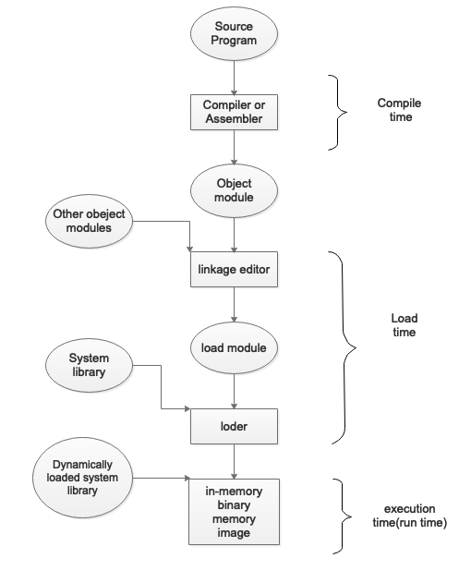
Multistep processing of user program
Figure – 3 Diagram of Multistep Processing of User program [3]

Slide 12
Memory Management Requirements
Relocation : when program get execute programmer does not know where the program will be placed in memory.
It may be swapped to disk and get return into main memory at different location while the program is executing.
Memory references must be translated in the code to actual physical memory address.

Slide 13
Memory Management Requirements
Protection: process need permission to reference memory locations into another process.
At compile time It is impossible to check absolute addresses
Checked at run time.

Slide 14
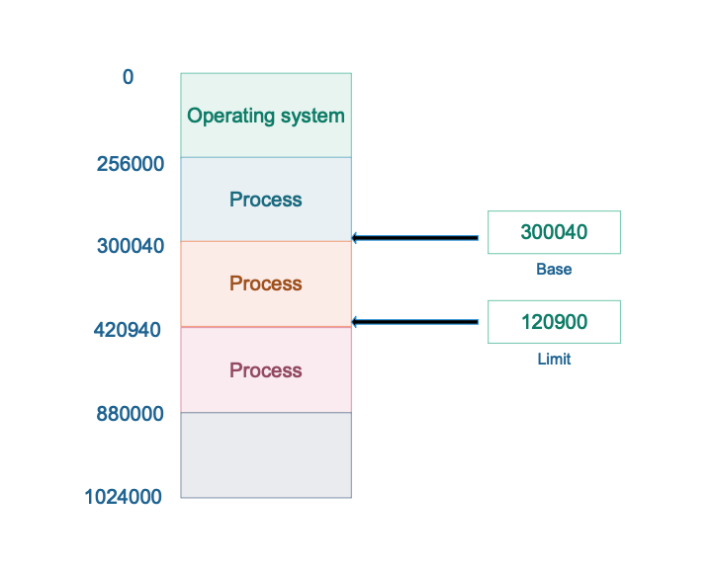
Base and Limit register: Memory Protection
Set of address that a process can use to address memory called an address space. It is range od valid addresses in a memory which are available for a program or process.
Start address of program is base
register.
Length of program is limit register.
Base and limit register only modify
by OS
Figure – 4 a based and a limit register define a logical address space [4]

Slide 15
Hardware Address protection using base and limit registers: Dynamic relocation
Assurance of memory space is practiced by having CPU equipment think about each address produced in client mode with the registers.
Any endeavor by client program running in client mode to get to the memory space of the working framework or some other client program, brings about a trap.
This plan restricts a client program from adjusting the code or information structure of the working framework or other client programs.

Slide 16
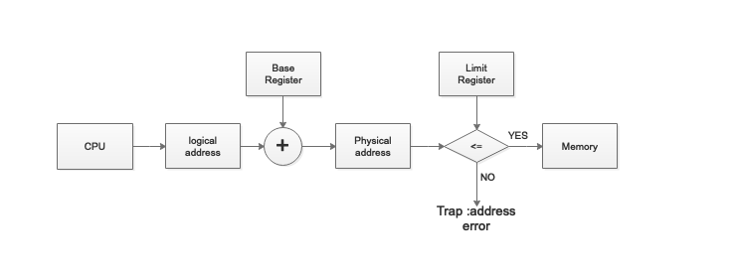
Hardware Address protection using base and limit registers: Dynamic relocation
Steps in dynamic relocation .
Equipment includes migration register (base) to the virtual location to get a physical location.
Equipment contrasts address and
breaking point register; the location
must be not exactly or equivalent
cutoff.
In the event that the test falls flat,
the processor takes a location
trap and overlooks the physical
location.
Figure – 5 Hardware address protection [5]

Slide 17
Static vs Dynamic Loading
Static | Dynamic
1.Entire program load into main memory before program start execution. | 1.On demand it load program into memory
2.Memory utilization is inefficient because it require or not it load whole program into main memory. | 2. Memory utilization is efficient because it load program on demand.
3. Fast execution of program | 3. Slower execution of program
4. Every time it takes load time when program load into main memory | 4. Perform at a run time by operating system
5. Static linking is applied if the static loading used accordingly | 5. dynamic linking is applied if the dynamic loading used accordingly
6.To start execution absolute data and program load into memory | 6. Bit by bit loading of data and information in run time

Slide 18
Swapping
For temporarily any process can be swapped out of memory to backing store and take back into memory for further execution.
Backing store : disk large enough so that can accommodate copies of all memory images for all users.
Roll out roll in: for priority based scheduling algorithm swapping variant used; to load high-priority process and to get execute lower priority process need to swapped out.
Ready queue maintain by the system for ready -to-run processes which have memory images on disk.

Slide 19
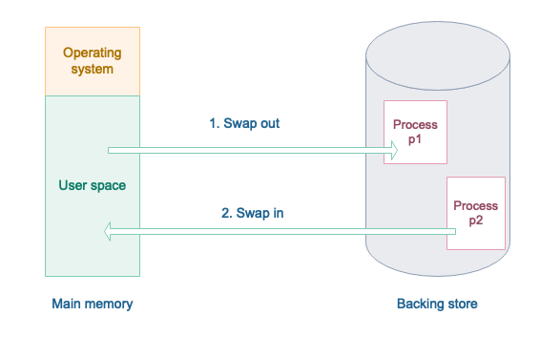
Schematic View of Swapping
Figure – 6 Schematic view Swapping [6]

Slide 20
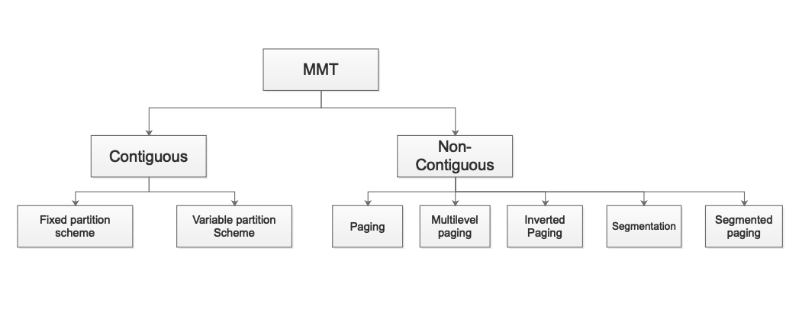
Memory Management Techniques (MMT)
Figure – 7 MMT [7]

Slide 21
Memory Allocation: Contiguous Memory Allocation
• Memory allocation is a mechanism by which computer programs and services are assigned with physical or virtual memory space.
• Memory allocation is the process of reserving a partially or entirely portion of computer memory.
• There are 2 types of memory allocation:
1. Contiguous memory allocation
2. Non – Contiguous memory allocation

Slide 22
Contiguous Memory Allocation
• Contiguous memory allocation is known as a memory allocation model in which a single contiguous adjacent area is allocated in the memory for each program.
• When a process needs to execute, memory is requested by the process.
• The size of the process is compared with the amount of contiguous main memory available to execute the process.
Notes:
‹#›

Slide 23
Contiguous Memory Allocation
• If enough contiguous memory is found, the process is allocated memory to start its execution.
• Otherwise, waiting processes are added to a queue until there is sufficient free contiguous memory available.
Notes:
‹#›

Slide 24
Contiguous Memory Allocation
• In operating systems, the contiguous memory allocation scheme can be implemented with the aid of two registers, known as base and limit registers.
• Main memory usually has two partitions :
Low Memory : Operating system resides in this memory.
High Memory : User processes are held in high memory.
Notes:
‹#›

Slide 25
Contiguous Memory Allocation
• Partitioning of memory can be done in the following ways:
1. Single Process Monitor
2. Multiprogramming with Fixed Partition
3. Multiprogramming with Variable Partition
Notes:
‹#›

Slide 26

Single Process Monitor
• Main memory is dividing into the two parts. One is part of O.S. and second for user process area.
• For example: Here main memory 0-400MB
space is reserve for the Operating System.
• Second part is part for user process in which
user’s process will be loaded into memory.
0
400MB
1000MB
Figure – 8 Single Process Monitor[9]

Slide 27
Single Process Monitor
• Only one process can load to memory in Single Process Monitor. The next process will be loaded into memory when one process is complete.
• Single process monitor does not support multiprogramming but only supports uniprogramming.
Notes:
‹#›

Slide 28
Multiprogramming with Fixed Partition (MFT)
• The main memory is divided into multiple partitions to support the multiprogramming.
• The number of partitions are fixed but the size of each partition can be different.
• Each process will store into these partitions contiguously.

Slide 29
Multiprogramming with Fixed Partition (MFT)
• Here only one process is allowed into one partition.
• The degree of multi-programming is equivalent to the number of partitions as there can be many processes in the main memory at one time

Slide 30

Multiprogramming with Fixed Partition (MFT)
• In fig.2 memory is divided into 5 equal size partitions. Each partition of 100MB.
Advantages of Fixed Partition:
1.Easy to implement.
2.Little OS overhead.
0
500
600
700
800
900
1000
Figure - 9 Multiprogramming with Fixed Partition[9]

Slide 31
Multiprogramming with Fixed Partition (MFT)
Disadvantages of Fixed Partition:
1.Internal Fragmentation
2.External Fragmentation
3.Limit process size
4.Limitation on Degree of Multiprogramming

Slide 32
Problems with Fixed Partitioning
• Main problem with this arrangement is fragmentation.
• Fragmentation is the presence of unusable areas in the computer memory
• There are two types of Fragmentation
1. Internal Fragmentation
2. External fragmentation
Notes:
‹#›

Slide 33

Multiprogramming with Variable Partition(MVT)
• Partitions are created dynamically to avoid the difficulties of the fixed partitions.
• No partition is fixed in memory in dynamic
partitions, but the partition is only created
when the process is loaded into memory.
0
500
650
750
800
1000
Figure - 10 Multiprogramming with Variable Partition[9]

Slide 34
Multiprogramming with Variable Partition(MVT)
• In figure above memory is divide into 4 unequal size partitions. Partition size is not equal.
• Here the not problem of internal fragmentation. But here the problem of external fragmentation.

Slide 35
Multiprogramming with Variable Partition(MVT)
Advantages of Variable Partition:
1.No internal fragmentation.
2.Efficient use of memory.
Disadvantages of Variable Partition:
1.Problem of external fragmentation.
2.Not easy to implement.

Slide 36
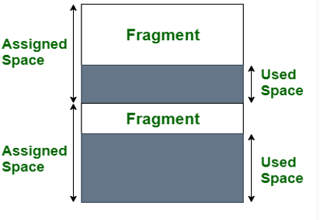
Internal Fragmentation
• Internal fragmentation occurs when the memory is divided into fixed sized blocks.
• Whenever a process request for the
memory, the fixed sized block is allocated
to the process.
Figure - 11 Multiprogramming with Variable Partition[13]

Slide 37
Internal Fragmentation
• In case the memory assigned to the process is somewhat larger than the memory requested, then the difference between assigned and
requested memory is the Internal Fragmentation.
•Internal fragmentation occurs when fixed sized memory blocks are allocated to the process without concerning about the size of the process.

Slide 38
Internal Fragmentation
• The diagram clearly shows the internal fragmentation because the difference between memory allocated and required space or memory is called Internal fragmentation.

Slide 39

Example of Internal Fragmentation
• Here p1, p2,p3,p4 is loaded into memory.
• Process P1 is loaded into first partition whose size is 150MB and size of process P1 is 110MB ,so in partition 40MB
space is waste.
• This is called Internal Fragmentation.
0
500
650
750
800
1000
Figure - 12 Example of Internal Fragmentation [13]

Slide 40
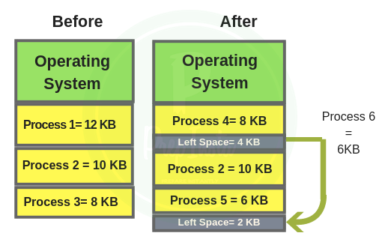
External Fragmentation
• When the process is loaded or removed from the memory, a free space is created. This free space creates an empty space in the memory which is called external fragmentation.
• When the memory assigned to the process
dynamically based on process request.
Figure - 13 Example of Internal Fragmentation [8]

Slide 41
External Fragmentation
• Memory is partitioned into variable size blocks.
• External fragmentation can be eliminated by compaction, paging, and segmentation so that memory can be allocated in a non-contiguous manner to a process.

Slide 42
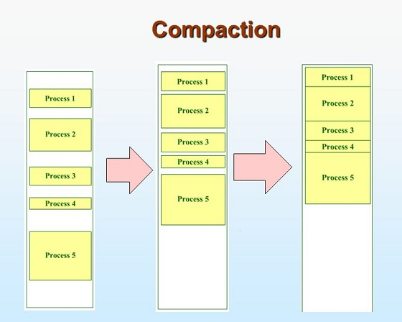
Compaction
• Compaction is one of the technique to avoid External Fragmentation.
• Move all the processes towards the top or
towards the bottom to make free available
space in a single contiguous block is known
as compaction.
Figure - 14 Example of Internal Fragmentation [13]

Slide 43
Compaction
• Compaction is undesirable to implement because it interrupts all the running processes in the main Memory.
• The other technique to avoid external fragmentation is to implement non-contiguous memory allocation techniques.

Slide 44
Paging: Principle of Operation
• In Operating Systems, Paging is a storage mechanism used to retrieve processes from the secondary storage into the main memory in the form of pages.
• The main idea behind the paging is to divide each process in the form of pages.
• The main memory will also be divided in the form of frames.

Slide 45
Paging: Principle of Operation
• One page of the process is to be stored in one of the frames of the memory.
• The pages can be stored at the different locations of the memory, but the priority is always to find the contiguous frames or holes. Different operating system defines different frame sizes.

Slide 46
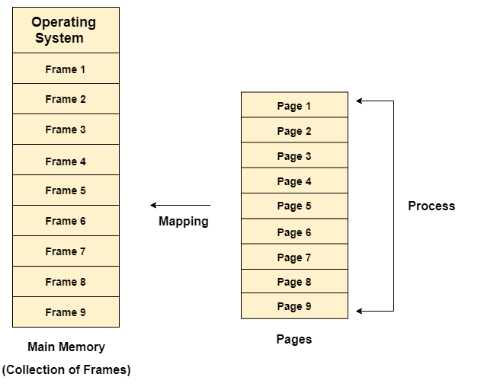
Paging: Principle of Operation
• The sizes of each frame must be equal. Considering the fact that the pages are mapped to the frames in
Paging, page size needs to be as same
as frame size.
Figure - 15 Paging [11]

Slide 47
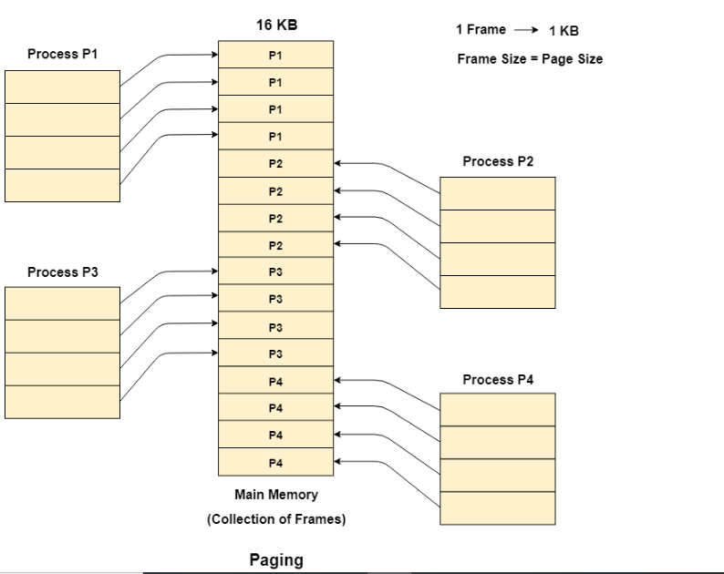
Example of Paging
• Let us consider the main memory size 16 Kb and Frame size is 1 KB therefore the main memory will be
divided into the collection of 16 frames
of 1 KB each.
• There are 4 processes In the system that
is P1, P2, P3 and P4 of 4 KB each.
Figure – 16 Example of Paging[11]

Slide 48
Example of Paging
• Each process is divided into pages of 1 KB each so that one page can be stored in one frame.
• Initially, all the frames are empty therefore pages of the processes will get stored in the contiguous way.

Slide 49
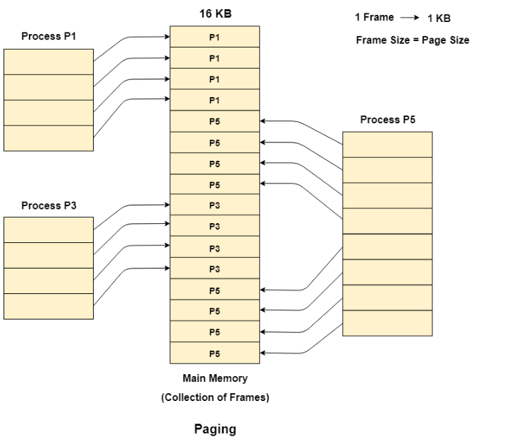
Example of Paging
• Let us consider that, P2 and P4 are moved to waiting state after some time.
• Now, 8 frames become empty and
therefore other pages can be loaded in that
empty place.
Figure - 17 Example of Paging[11]

Slide 50
Example of Paging
• The process P5 of size 8 KB (8 pages) is waiting inside the ready queue.
• Given the fact that, we have 8 non contiguous frames available in the memory and paging provides the flexibility of storing the process at the different places. Therefore, we can load the pages of
process P5 in the place of P2 and P4.

Slide 51
Memory Management Unit
• The purpose of Memory Management Unit (MMU) is to convert the logical address into the physical address.
• The logical address is the address generated by the CPU for every page while the physical address is the actual address of the frame where each page will be stored.

Slide 52
Memory Management Unit
• The logical address has two parts:
1. Page Number
2. Offset
• Memory management unit of OS needs to convert the page number to the frame number.
.

Slide 53
Physical Address Space
• Physical address space in a system can be defined as the size of the main memory.
• It is really important to compare the process size with the physical address space. The process size must be less than the physical address space.
• Syntax of Physical Address Space is:
Physical Address Space = Size of the Main Memory
.

Slide 54
Example of Physical Address Space
If, physical address space = 64 KB = 2 ^ 6 KB = 2 ^ 6 X 2 ^ 10 Bytes = 2 ^ 16 bytes
Let us consider,
word size = 8 Bytes = 2 ^ 3 Bytes
Hence,
Physical address space (in words) = (2 ^ 16) / (2 ^ 3) = 2 ^ 13 Words
Therefore,
Physical Address = 13 bits
.

Slide 55
Logical Address Space
• Logical address space can be defined as the size of the process. The size of the process should be less enough so that it can reside in the main memory.
For Example of Logical Address Space is:
Logical Address Space = 128 MB = (2 ^ 7 X 2 ^ 20) Bytes = 2 ^ 27 Bytes
Word size = 4 Bytes = 2 ^ 2 Bytes
Logical Address Space (in words) = (2 ^ 27) / (2 ^ 2) = 2 ^ 25 Words
Logical Address = 25 Bits

Slide 56
Logical Address Space
• What is a Word?
The Word is the smallest unit of the memory. It is the collection of bytes. Every operating system defines different word sizes after analyzing the n-bit address that is inputted to the decoder and the
2 ^ n memory locations that are produced from the decoder.
.

Slide 57
Page Table
• Page Table is a data structure used by the virtual memory system to store the mapping between logical addresses and physical addresses.
• Logical addresses are generated by the CPU for the pages of the processes therefore they are generally used by the processes.
• Physical addresses are the actual frame address of the memory.
• They are generally used by the hardware or more specifically by RAM subsystems.

Slide 58
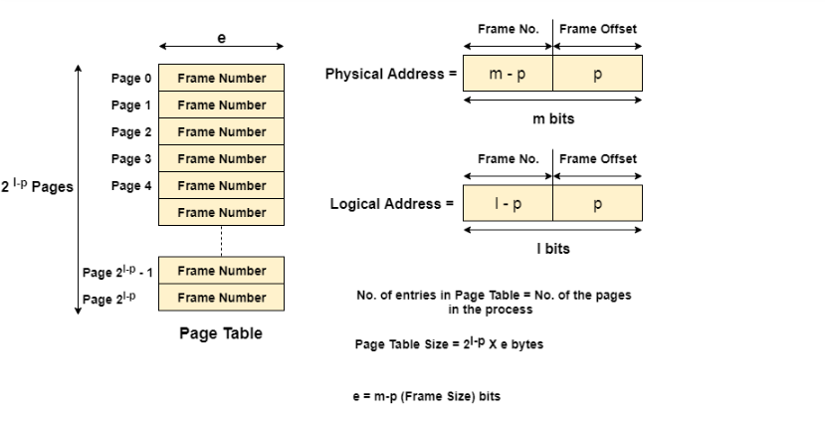
Representation of Physical and Logical Address
Figure - 18 Representation of Physical and Logical Address [10]

Slide 59
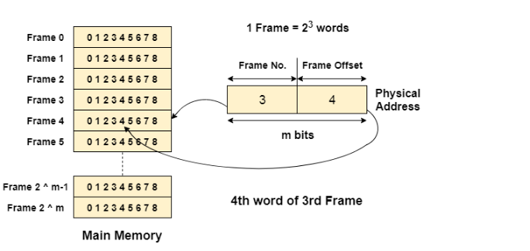
Example of Page Table
Figure - 19 Example of Page Table[10]

Slide 60
Mapping From Page Table To Main Memory
• In operating systems, there is always a requirement of mapping from logical address to the physical address.
• However, this process involves various steps which are defined as follows.
Step 1: Generation of logical address

Slide 61
Mapping From Page Table To Main Memory
Step 2: To determine the actual page number of the process, CPU stores the page table base in a special register. Each time the address is generated, the value of the page table base is added to the page number to get the actual location of the page entry in the table. This process is called scaling.

Slide 62
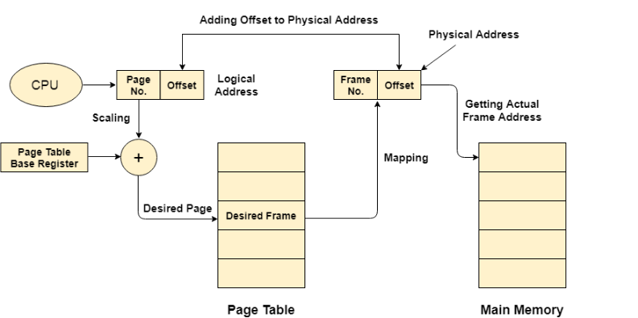
Mapping From Page Table To Main Memory
Step 3:Generation of physical Address.
Step 4: Getting Actual Frame
Number.
Figure – 20 Mapping From Page Table to Main Memory [10]

Slide 63
Page Allocation
• Paged allocation in memory management divides computer physical memory (Random Access Memory – RAM) into fixed size of memory units called page frames (memory block size).
• Also divides virtual address space to size of the pages.

Slide 64
Page Allocation
• The main advantage of using paged allocation is, an empty page frame can be used by any job however, need to keep track of number of pages and where the pages of individual job are located in memory.
• In other words memory can be used efficiently and each job runs on its own address space. Frames, pages and the mapping between the
two is shown in the .

Slide 65
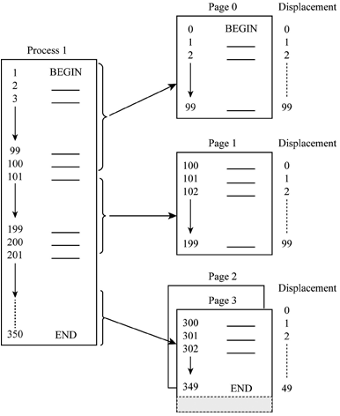
Example of Page Allocation
• From figure, the size of each page is
100 memory locations.
• The memory utilized by the process1
in the given figure is 350 memory
locations where it takes 4 pages to
store 350 memory locations.
Figure - 21 Example of Page Allocation [12]

Slide 66
Example of Page Allocation
• That is, in memory block 0 or page 0 holds first 100 memory locations of data.
• In second page, memory locations of 100 to 199 are stored and so on.

Slide 67
Steps to determine exact location of the instruction or code line
• Find the page number and displacement.
• Determine memory block size which contains required page.
• Obtain the address of beginning of the first memory block.

Slide 68
Steps to determine exact location of the instruction or code line
• Add the displacement to starting address of memory blocks if the required page is in other than page 0.
• When the system moves required pages from main memory to secondary memory it gives rise to demand paging, in other words, moving only the required page to physical memory.

Slide 69
Hardware Support
Each OS has its own method for storing page tables.
Page table for each process is there.
Pointer to the page table is stored with other register values in PCB.
The h/w implementation of page table can be done in several ways.

Slide 70
Hardware Support
The page table is implemented as a set of dedicated registers.
The main use of registers for the page table is satisfactory if the page table is reasonably small.
But current systems have Page table size that is very large, so use of only registers is not feasible.

Slide 71
Hardware Support
Using Translation look-aside buffer (TLB).
The problem of previous approach is the time required to access a memory, with this scheme 2 memory access required like, a P.T. is kept in M.M., and a page- table based register (PTBR) points to the page table.
The solution of this problem is to use a special, small, fast-lookup hardware, known as translation look-aside buffer (TLB).

Slide 72
TLB ( Translation Look-Aside Buffer)
It is associative, high speed memory.
Each entry in TLB consists of 2 parts:
a key (tag)
a value.

Slide 73
TLB ( Translation Look-Aside Buffer)
TLB used with P.T. in following way:
It contains a few of the page-table entries.
When a logical address is generated by the CPU, its page no. is presented to the TLB.
If the page no. is found in TLB, its frame no. is immediately available and is used to access memory.
If the page no. is not in TLB (known as TLB miss), a memory reference to the page table must be made.
When the frame no. is found then we can use it to access memory.

Slide 74
TLB ( Translation Look-Aside Buffer)
Example:-
A CPU generates 32-bit virtual addresses and the page size is 4 KB. The processor have translation look-aside buffer (TLB) which can hold a total of 128 page table entries and it is 4-way set associative.
Now calculate the minimum size of the TLB tag.

Slide 75
TLB ( Translation Look-Aside Buffer)
Answer:-
Here, size of a page = 4KB = 2^12
Total number of bits required to address a page frame = 32 – 12 = 20
If there are ‘n’ cache lines in a set, the cache placement is called n-way set associative.
TLB is 4 way set associative and can hold total 128 (2^7) page table entries, number of sets in cache = 2^7/4 = 2^5.
So 5 bits are needed to address a set, and 15 (20 – 5) bits are needed for tag.

Slide 76
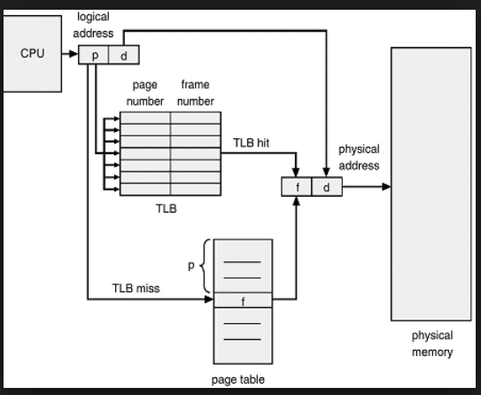
Paging Hardware with TLB
Figure – 22 Paging hardware with TLB [15]

Slide 77
Paging Hardware with TLB
Now add that page no. and frame no. into TLB so that next time it would be helpful to access a physical memory.
If the TLB is full of entries, some of them can be removed. This decision has been taken by using LRU algorithm.
Some TLBs allowed entries to be wired down that means it can’t be removed.
Some TLBs store address-space identifiers (ASIDs) in each TLB entry.

Slide 78
Paging Hardware with TLB
ASID –uniquely identify each process and used to provide address space protection to corresponding process.
It ensures that the ASID for the currently running process must matches with the virtual page that it is now resolving.
If it doesn’t match , it is known as TLB miss.
An ASIDs allow TLB to contains different process simultaneously.
If the TLB does not support separate ASIDs, then every time a different page table is selected, and the previous TLB must be erased.

Slide 79
Paging Hardware with TLB
The percentage of times that a page is found in TLB is known as hit ratio.
For Example:-
80 % hit ratio means we find desired page in 80 percent of time.
It takes 20 nanosecond to search the TLB and 100 nanoseconds to access memory. So mapping requires total 120 nanoseconds total.
If its not in TLB then, 20 ns for TLB search, 100 ns for memory access for page table, then 100 ns for mapping, so total 220.
Effective Access time = (0.80 *120) + (0.20 * 220)
= 140 ns

Slide 80
Paging Hardware with TLB
Example:- 2
If hit ratio increase as 98 %
Effective Access time = (0.98 *120) + (0.02 * 220)
= 122 ns

Slide 81
Advantages of Paging
Memory allocation and de-allocation is very fast.
It is noncontiguous memory allocation so we do not require contiguous memory space for one process.
No external fragmentation problem.
Swap-in and Swap-out operations are performed fast.

Slide 82
Disadvantages of Paging
This technique is suffering with internal fragmentation.
For Example:-
If pages are 120 bytes, a process of 400 bytes requires 3 pages + for 40 bytes it requires again 1 page. So total 4 pages will be allocated.
(120-40) = 80 bytes size will be free and its internal fragmentation.
It requires more size of memory to store page table. As the page number increases the page table size is increase.

Slide 83
Memory Protection
Memory protection in paging must be required. That is frame allocated to the one page cannot be reallocated to other page meanwhile one page is allocated to it.
This memory protection can be performed by using one special bit associated with each frame, and stored in page table, that is Protection Bit.
Page table has index starting from 0 to maximum allowed page in memory.

Slide 84
Memory Protection
But we are not using all pages at a time so to find out which page is used and write now present in memory and which is not we are using one special bit that is known as Valid/Invalid bit as shown in fig.
Instead of using valid/invalid bit to determine the use of the page, some system uses Page Table Length Register (PTLR) which indicates the actual size of the page table and from it we can know the last valid address of page

Slide 85
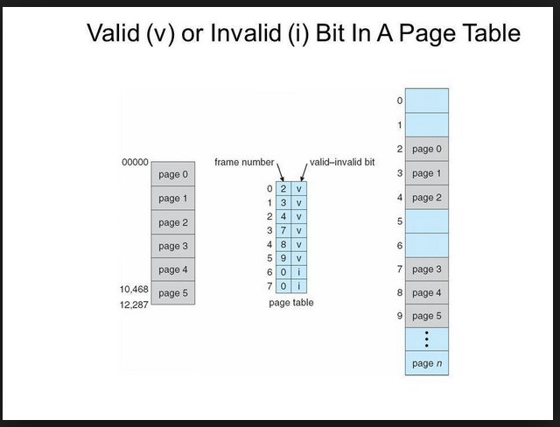
Memory Protection
Figure – 23 Valid(v) or invalid(i) bit in a page table [15]

Slide 86
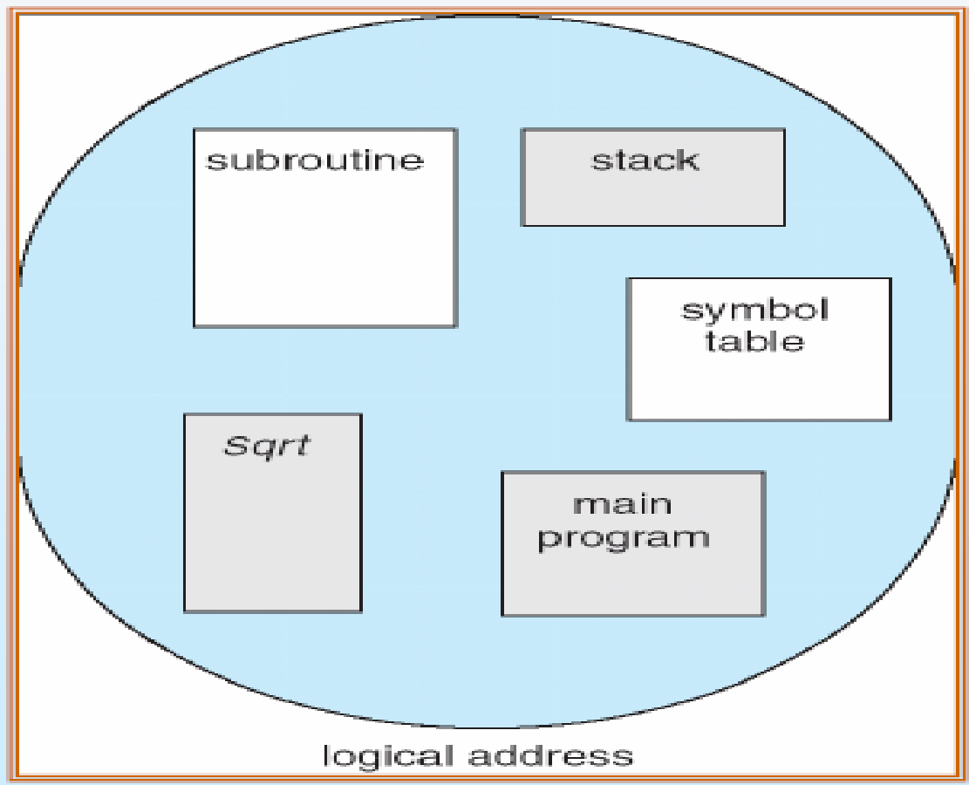
Segmentation
Segmentation is a memory-management scheme that supports user view of memory and contains segment.
In fig. we can see that memory is
divided into multiple segments like,
subroutine, stack, code, heap, etc.
Figure – 24 Memory segmentation [15]

Slide 87
Segmentation
Users or programmers specify each address by 2 quantities:
1) a segment name
2) an offset. (contrast to the paging)
For easiest way of implementation, segments are numbered and referred by segment no. rather than name.

Slide 88

Segmentation
So logical address consists of 2 tuple:
<segment-number, offset>
Here, Segment-number is used to identify a segment.offset is an original location within a segment.
Segment 1
Segment
name
offset
Logical Address Space
- Collection of segments

Slide 89
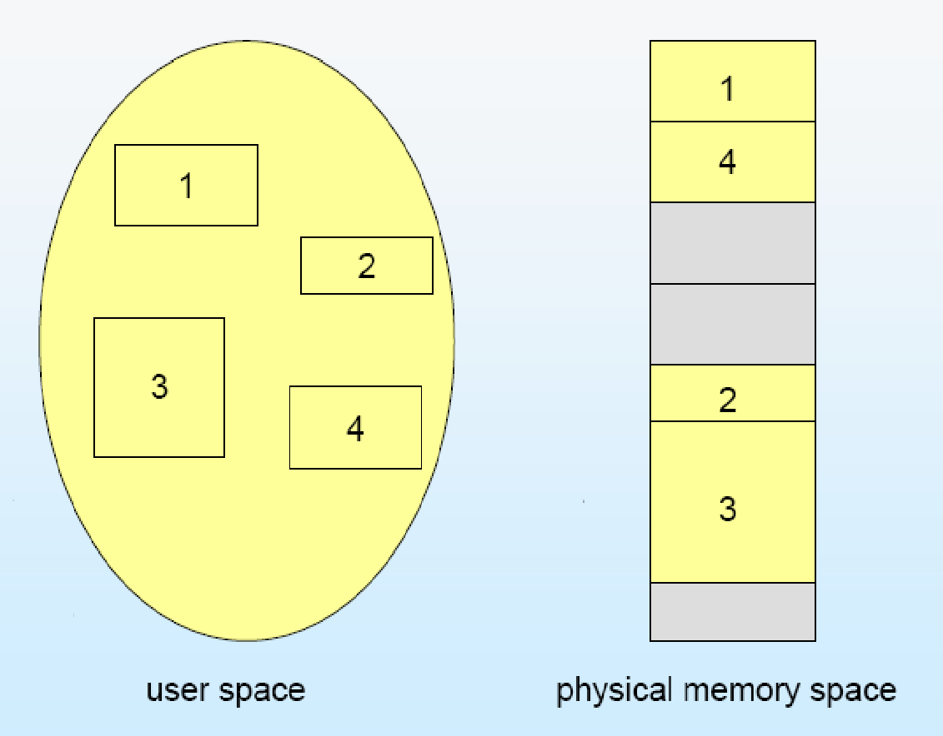
Segmentation
Figure – 25 Memory Segmentation [15]

Slide 90
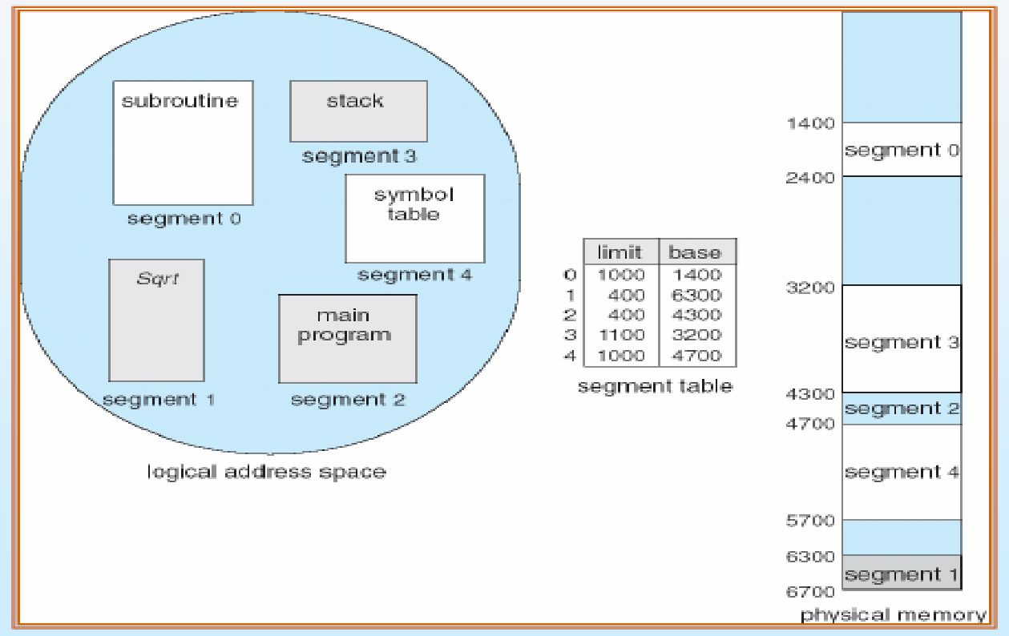
Example of Segmentation
Figure – 26 Memory Segmentation Example [15]

Slide 91
Hardware Implementation of Segmentation
Logical address is 2D
Physical address is 1D
Thus, we must define an implementation that maps 2d into 1d.
This mapping is overdone by a Segment Table.
Each entry of the segment table has Base and Limit. The segment base contains the starting address of the segment where as limit specifies the length of the segment.

Slide 92
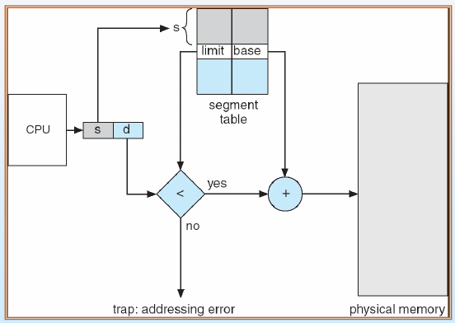
Hardware Implementation of Segmentation
Figure – 27 Address generated by the CPU in segmentation [15]

Slide 93
Hardware Implementation of Segmentation
A logical address consists of 2 parts: s & d.
Here, S is used as an index into segment table
- a value of D must be lies between 0 and segment limit.
- If its not, it will be trapped to OS.
For Example,
Segment 2 is 400 bytes long. Begins at 4300.
It will check 53 < 0 – limit ( i.e. 400)
So that, a reference to byte 53 of segment 2 is mapped as
4300 + 53 = 4353.
now check for 1222 byte for segment 0 .
1222 < 0 – 1000 , which is false so it will be trapped to OS.

Slide 94
Difference between Segmentation and Paging
 | Segmentation | Paging
1 | Program is divided into variable size segments. | Program is divided into fix size of pages.
2 | Segmentation is slower than paging. | Paging is faster than segmentation.
3 | Segmentation is visible to the user. | Paging is invisible to the user.
4 | Segmentation eliminates internal fragmentation. | Paging suffers from internal fragmentation.
5 | Segmentation suffers from external fragmentation. | There is no external fragmentation.
6 | OS maintain a list of free holes in main memory. | OS must maintain a free frame list

Slide 95
Advantages of Segmentation
Segmentation is useful for memory management.
Using segmentation users can partition their programs into number of subtask i.e. modules which are operate independently from each another.
Segments increases data sharing between two processes.
Segmentation allows to extend the address ability of a processor
Segmentation provides facility to separate the memory areas for heap, code, stack, data, etc.

Slide 96
Disadvantages of Segmentation
In segmentation external fragmentation is mostly present.
Costly algorithm.
Segmentation finds free memory area big enough.
When we use paging it generates list of free pages.
Implementation is very complex.

Slide 97
Structure of Page Table
It can be classified as:
Hierarchical Paging (Multilevel Page Table).
Inverted Page Table.
Hashed Page Table.

Slide 98
Hierarchical Paging (Multilevel Page Table)
Multilevel Paging is a paging scheme which contains two or more than two levels of page tables in a hierarchical manner. It is also known as hierarchical paging.
The entries of the level 1 page table are points to a level 2 page table, same way entries of the level 2 page tables are pointers to a level 3 page table and so on.
The entries of the last level P.T. are stores actual frame information.
Level 1 contain single page table and the address of that table is stored in to the PTBR (Page Table Base Register).

Slide 99
Two – Level Paging Example
We can divide a logical address (on 32-bit machine with 1K page size) is divided into following: - a page number consisting of 22 bits - a page offset consisting of 10 bits
So that the page table is paged, the page number is again divided into following: - a 12-bit page number - a 10-bit page offset (p2)

Slide 100
Two – Level Paging Example
Thus, a logical address is as follows: page number page offset
where, - the outer page table use p1 as an index number - p2 is the rearrangement within the page of the inner page table Known as forward-mapped page table
p1
p2
d
12 10 10

Slide 101
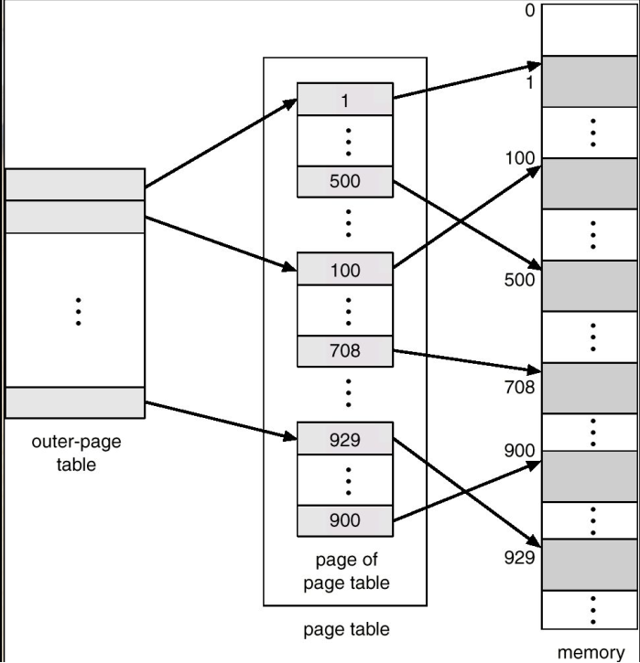
Two – Level Page Table Scheme
Figure – 28 Two level page table [15]

Slide 102
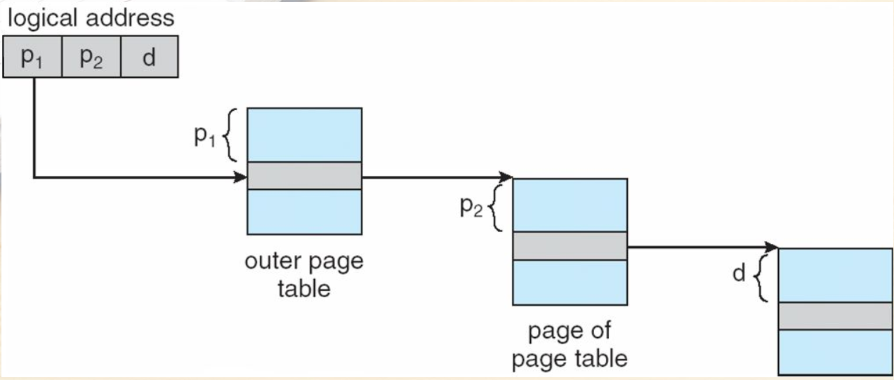
Address Translation Scheme
Figure – 29 Address translation scheme [15]

Slide 103
2) Hashed Page Table
Common in address spaces > 32 bits
The virtual page no. is hashed into a page table - This page table stores a chain of elements hashing to the same location
Each element contains:
(1) the virtual page number
(2) the value of the mapped page frame
(3) a pointer to the next element
Virtual page numbers are compared with this chain searching for a match
If a it is found, the related physical frame is extracted

Slide 104
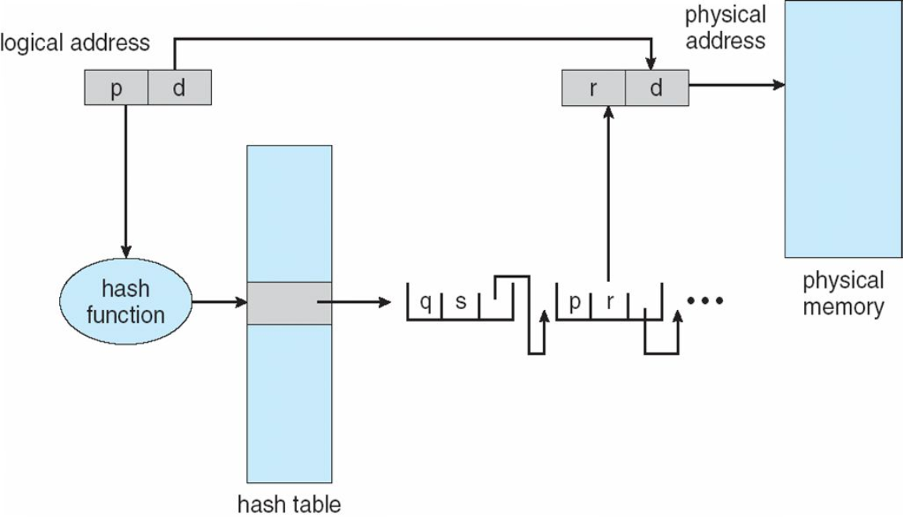
2) Hashed Page Table
Figure – 30 Working of hashed page table [15]

Slide 105
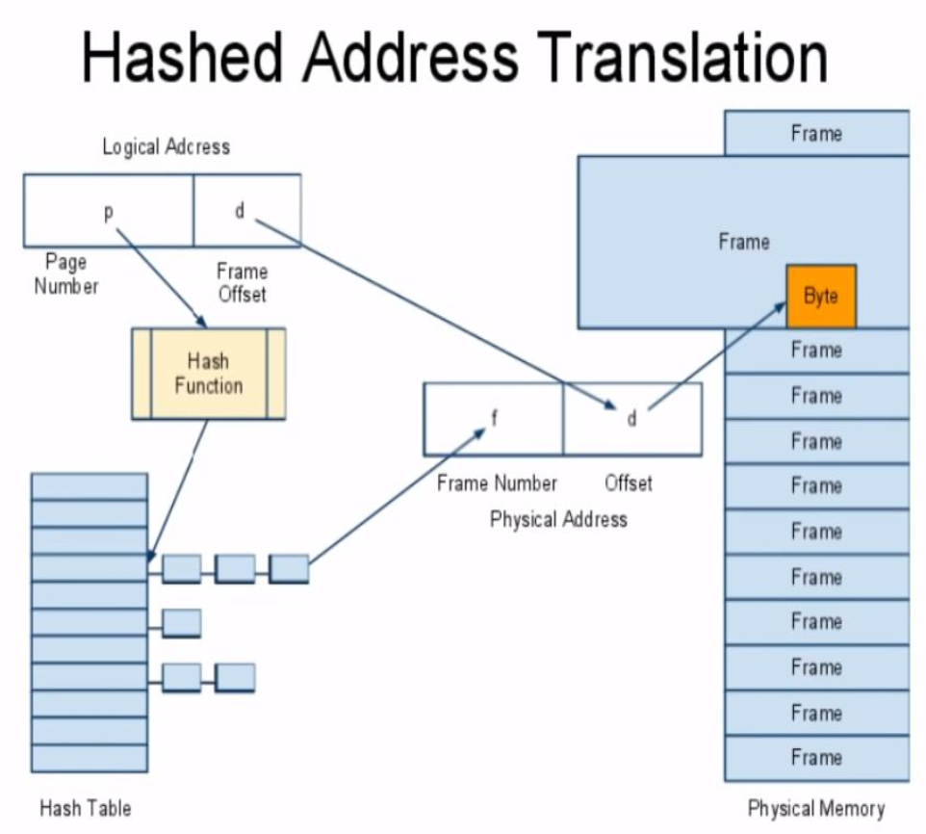
Hashed Address Translation
Figure – 31 Hashed address translation [15]

Slide 106
3) Inverted Page Table
Preferably each process having a page table and keeping track of all possible logical pages, track all physical pages.
Inverted page table keeps one entry for each real page (or frame) of memory.
This entry contains the virtual address of the page stored in that real memory location, along with information about the process that owns that page.
Table stores the corresponding value of pid and page no.
Decreases memory needed to store each page table, but required more time to search the table when a page reference occurs

Slide 107
3) Inverted Page Table
Requires the linear search of the entire table to perform the translation from page to frame. But it is inefficient in terms of performance.
Use hash table to limit the search to one — or at most a few — page-table entries TLB can accelerate access

Slide 108
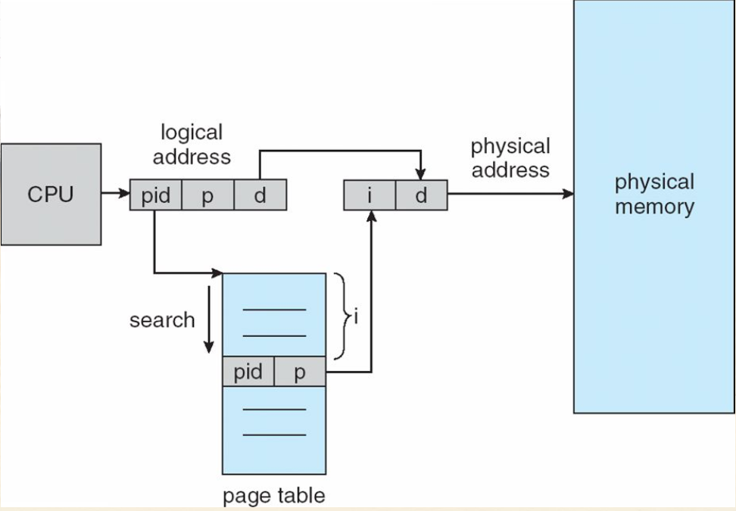
3) Inverted Page Table Architecture
Figure – 32 Architecture of inverted page table [15]

Slide 109
References
[1]https://www.researchgate.net/publication/319529366_Emerging_NVM_A_Survey_on_Architectural_Integration_and_Research_Challenges/figures?lo=1
[2] https://www.techtud.com/short-notes/logical-vs-physical-address-space
[3] https://basicittopic.com/memory-management/
[4] https://professormerwyn.wordpress.com/tag/logical-address-space/
[5]https://www.cs.uic.edu/~jbell/CourseNotes/OperatingSystems/8_MainMemory.html
[6] https://www.inf.ed.ac.uk/teaching/courses/os/slides/09-memory16.pdf

Slide 110
References
[7] https://www.geeksforgeeks.org/implementing-non-contiguous-memory-management-techniques/
[8]Operating Systems: Internals and Design Principles, by William Stallings.
[9]Operating Systems: Design and Implementation, Textbook by Andrew S. Tanenbaum.
[10]Operating System Concepts by Galvin
[11]Modern Operating Systems, Andrew S. Tanenbaum
[12]Operating system concepts by Abraham Silberschatz.Peter B Galvin.Gerg
[13]OPERATING SYSTEMS MEMORY MANAGEMENT by Jerry Breecher.

Slide 111
References
[14]Operating System Generations. Tutorialspoint. https://www.tutorialspoint.com/operating-system-generations
[15]Image source www.google.com

Slide 112


www.paruluniversity.ac.in

